Slide 1
Linguistics 200, Week 15
Making the Final Product

Slide 2
Instructions
Here is what you need to do for your final component.
1) Components 1-4 edited. Edits to the past components should reflect comments and feedback from your instructor, any changes made to the language after a component was submitted, and changes made to keep the language consistent.
ii) A creative work translated from English into your language. Your component must include:
a) An interlinear translation. Put this translation at the end of your Google document.
b) A video recording of the translation, in which all group members perform the language in roughly an equal fashion. This recorded must be accompanied by images/video and the translation itself in video format. See Creating Your Own Language, a How To: Final Project and the models provide for more. You should upload a file or submit a link to your creative work in this Canvas assignment.
c) You will present your language & your video to the class, in person, on Wednesday, May 5.

Slide 3
Overview of Mɤɧøɴ
Their culture
Their sound system
Their word system
Their writing system

Slide 4
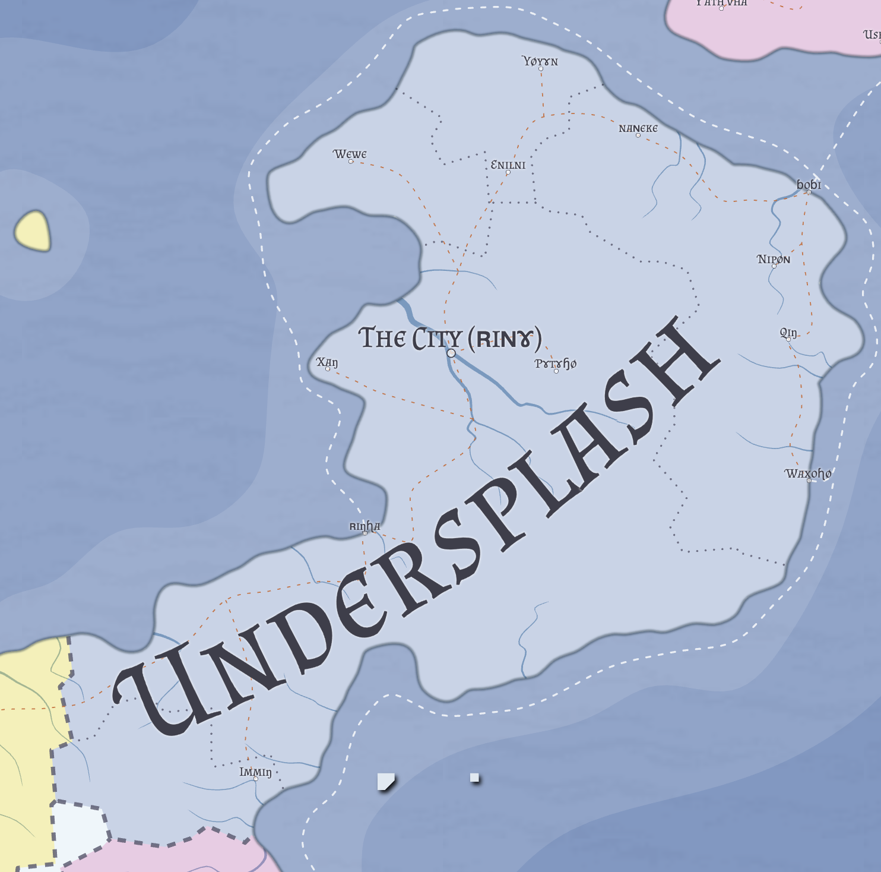

Culture

Slide 5
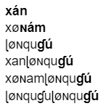
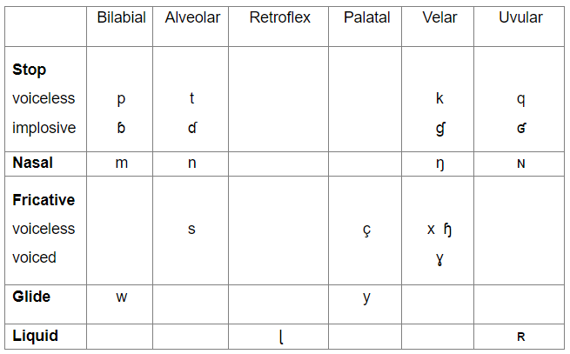
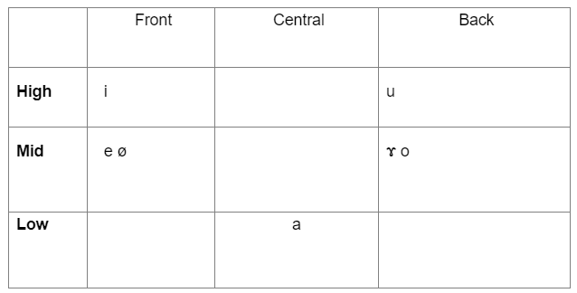
Sound System

Slide 6

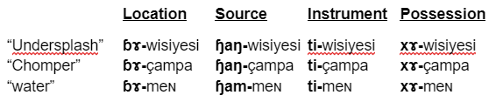
Word System

Slide 7
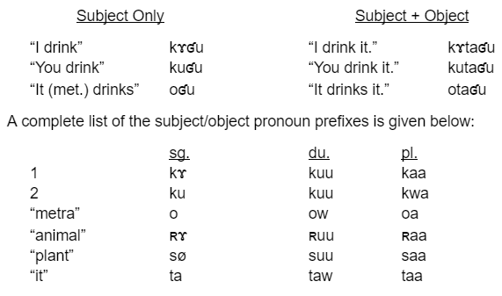
Word System

Slide 8
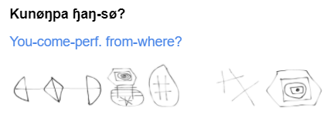
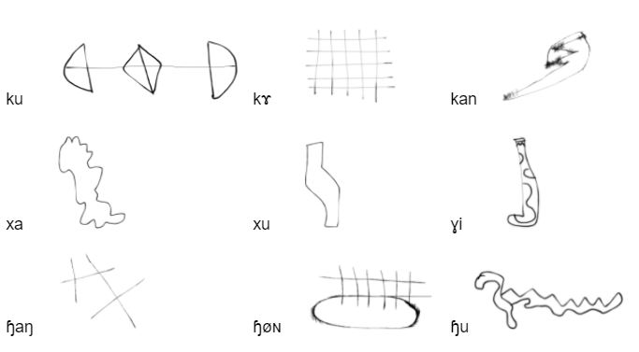
Writing System

Slide 9
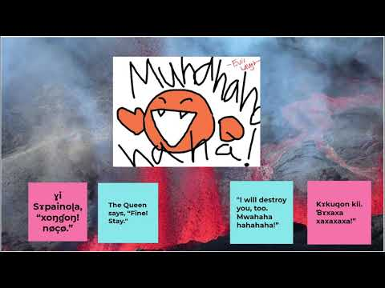

Slide 10
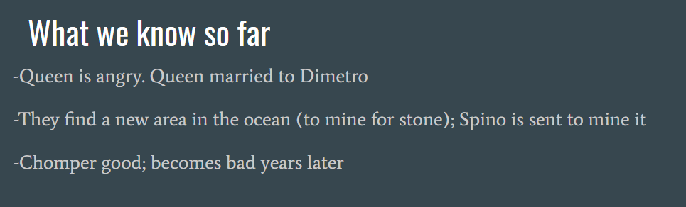
How we did it
Composed the work in English first

Slide 11
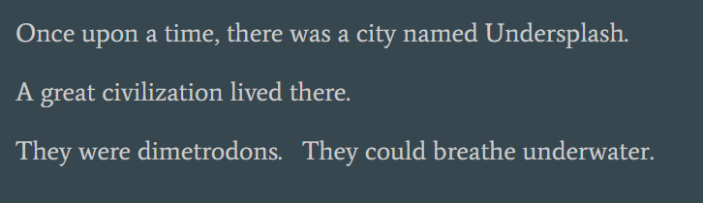
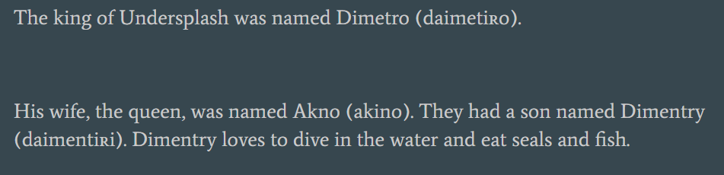
How we did it
Composed the work in English first

Slide 12
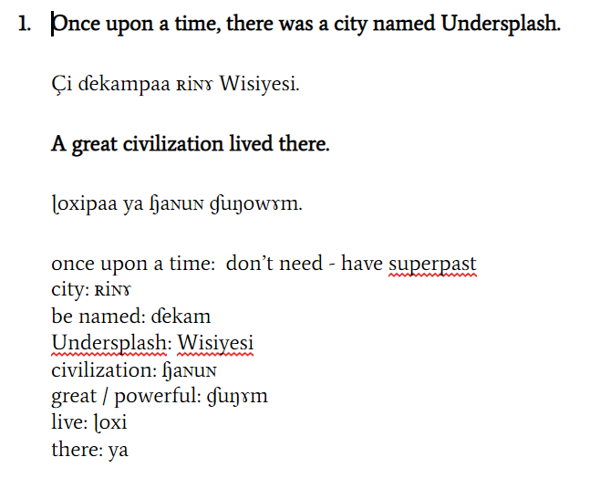
How we did it
2. Interlinear translation, paying attention to how grammar differs between English & Metra

Slide 13
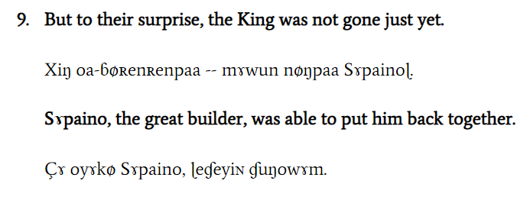
How we did it
But they were surprised
2. Interlinear translation
Also focus on idioms / non-literal expressions -- is there a way that you can express it more simply?

Slide 14
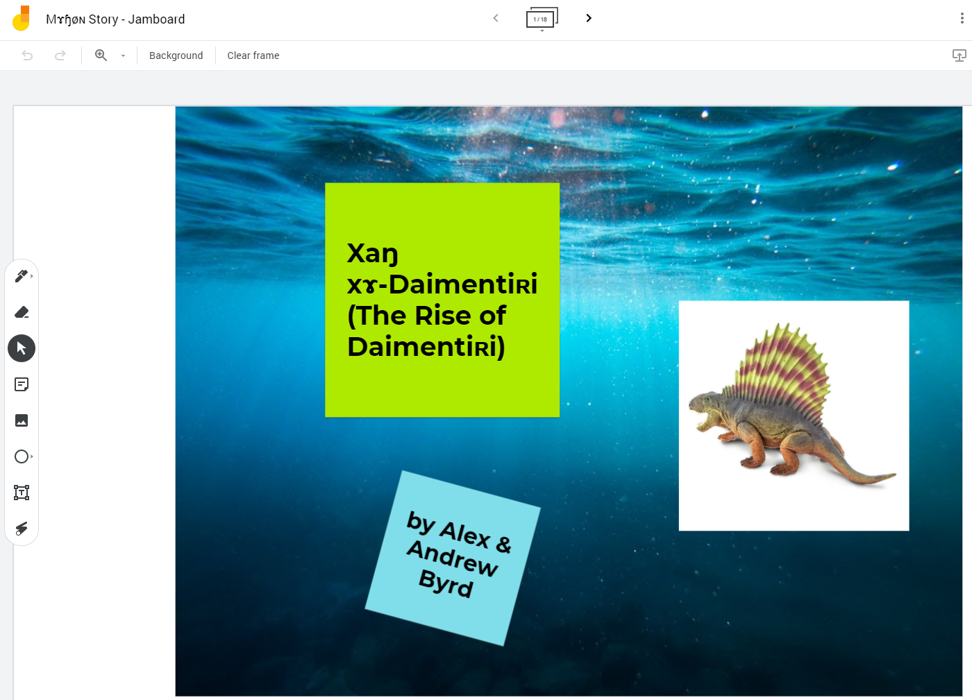
How we did it
3. Create visuals using Jamboard (you can use anything, really!)
Each slide “snipped” as image files

Slide 15
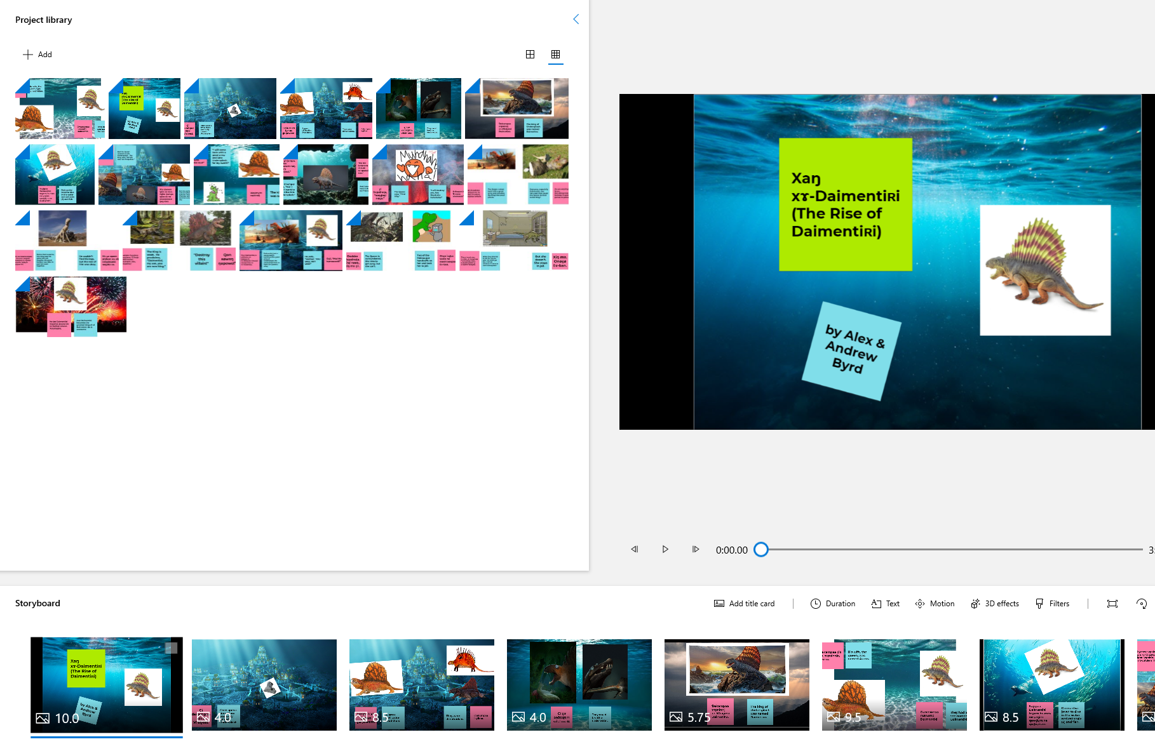
How we did it
4. Created a project in Microsoft Photos (PC) within the Video Editor (it’s free!)

Slide 16
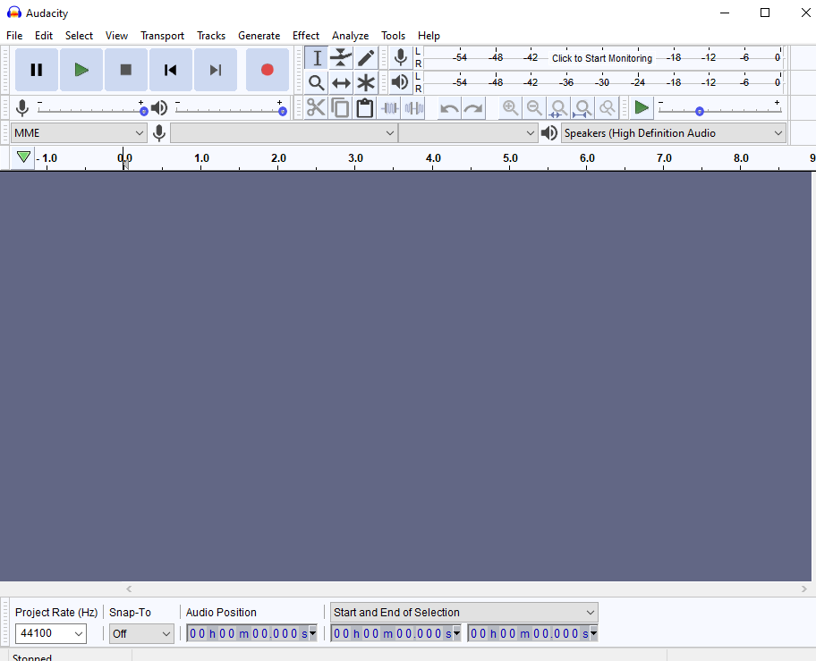
How we did it
5. Recorded audio using Audacity (it’s free!)

Slide 17
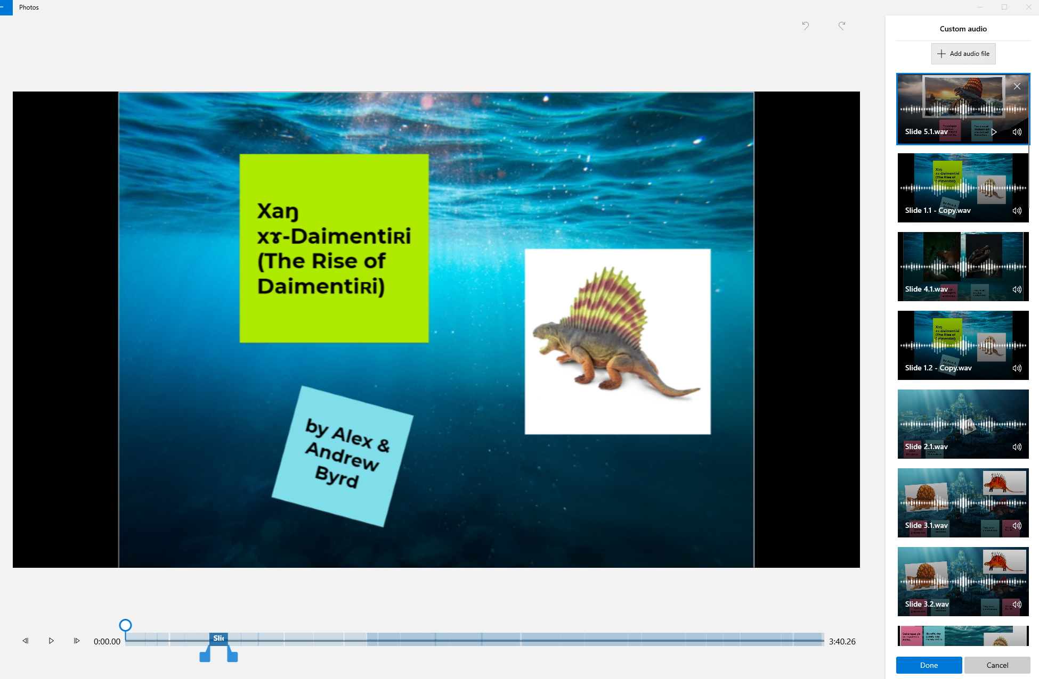
How we did it
6. Custom Audio in Photos

Slide 18
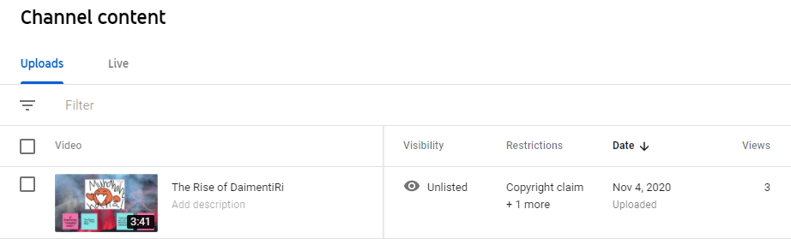
How we did it
7. Uploaded to Youtube as “unlisted”

Slide 19
Working on a Mac / iPad?
https://www.apple.com/imovie/

Slide 20
First Step : WRITE SOMETHING
Wednesday, 12/1 -- Rough Draft of Your Creative Work
It does NOT have to be a story (like Alex’s and mine)
It can be: a poem, a song, a skit, a cartoon, a video game, etc. etc. etc.
You need to have the creative work sketched out, in English

Slide 21
Monday / Wednesday, 12/6 - 12/8 -- Presentation
Who are your language speakers, what is their culture? Where do they come from?
What is the sound system?
What is the word system?
What is the writing system?

